Slide 1
Find today’s quiz #3 at http://www.humanaiclass.org/
History of Artificial Intelligence

Slide 2
Today’s learning goals
Describe the objectives of intelligence augmentation in contrast to artificial intelligence
Recognize different kinds of intelligence augmentation
Describe assumptions of humans that lead to these kinds
Apply interactional patterns such as agents & direct manipulation for intelligence augmentation
Critique approaches to intelligence augmentation.
Designing systems is a responsible job. What you do matters. Maybe more than you’d like.

Slide 3
AI vs. IA
Artificial intelligence ~ building a human-like intelligence (for specific kinds of tasks?)
Intelligent augmentation/amplification:
Computing machines will do the routinizable work that must be done to prepare the way for insights and decisions in technical and scientific thinking (Licklider’s description)
“elegant combination of reasoning machinery and direct manipulation.” (Horvitz’s description)

Slide 4
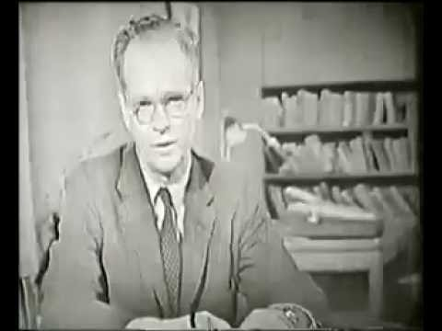
Skinner teaching machine

Slide 5
Skinner teaching machine
Is it AI or augmenting the teacher?
What if you look at it from the student’s point of view?

Slide 6
Structured share
Consider the questions on the slide
Think of your answer first, independently
Talk with others at your table -- do you agree? If not, discuss! If yes, discuss why
Share with class (one per table)

Slide 7
Assumptions about humans in the teaching machine?
What do students do?
How do they learn?
Why don’t they learn well without the machine?
What about the teacher?
How do they teach?
What are we missing?

Slide 8
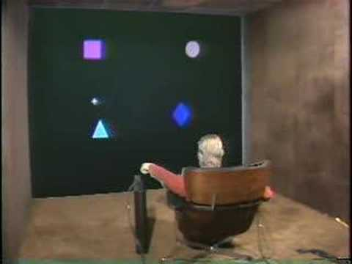
Put that there

Slide 9
“Put that there” assumptions
About speech transcription:
Why do you need to point?
Why do you need to talk?
What might go wrong?
About people:
How would this augment them?
How might it fail?
What might Eric Horvitz say?

Slide 10
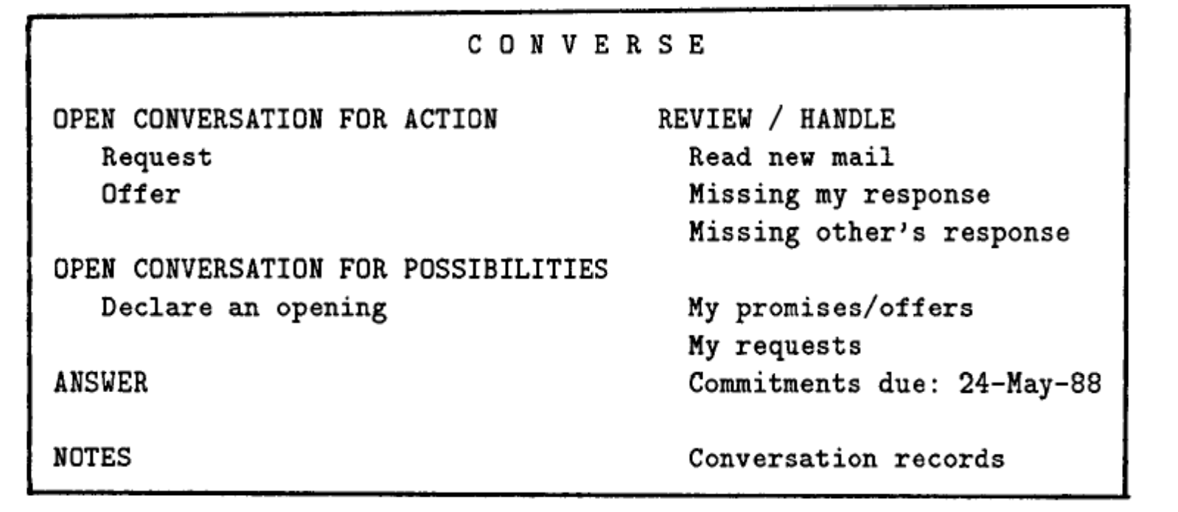
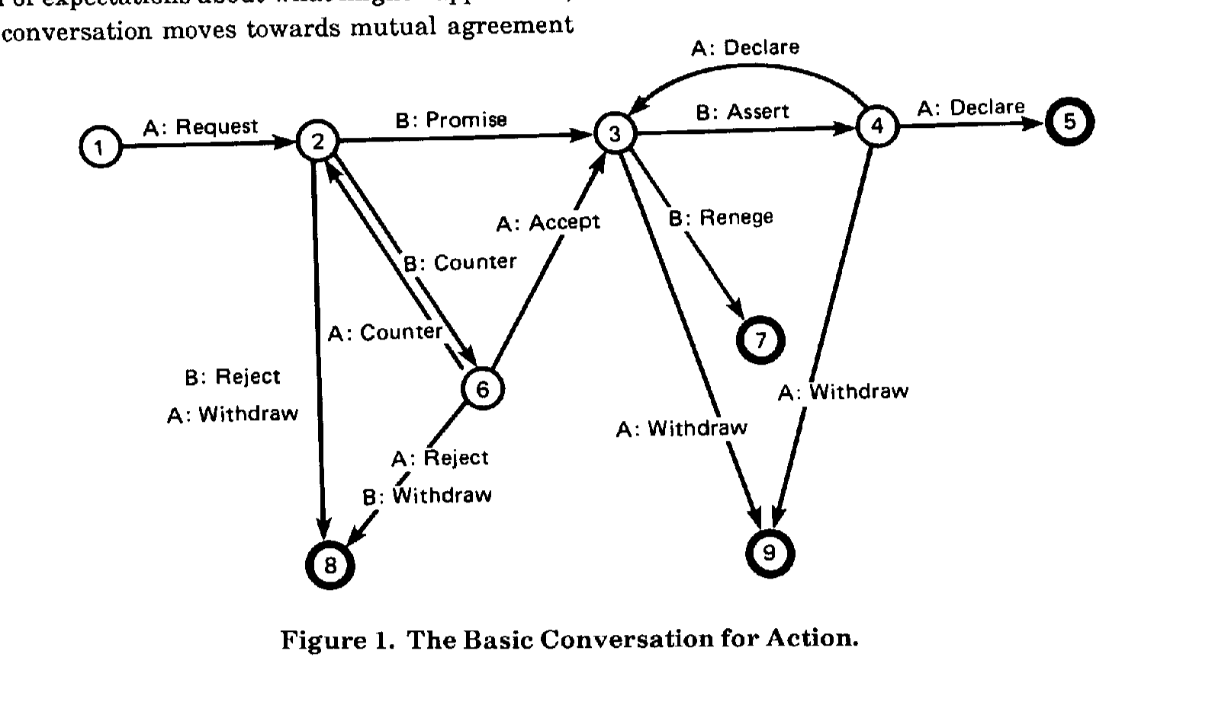
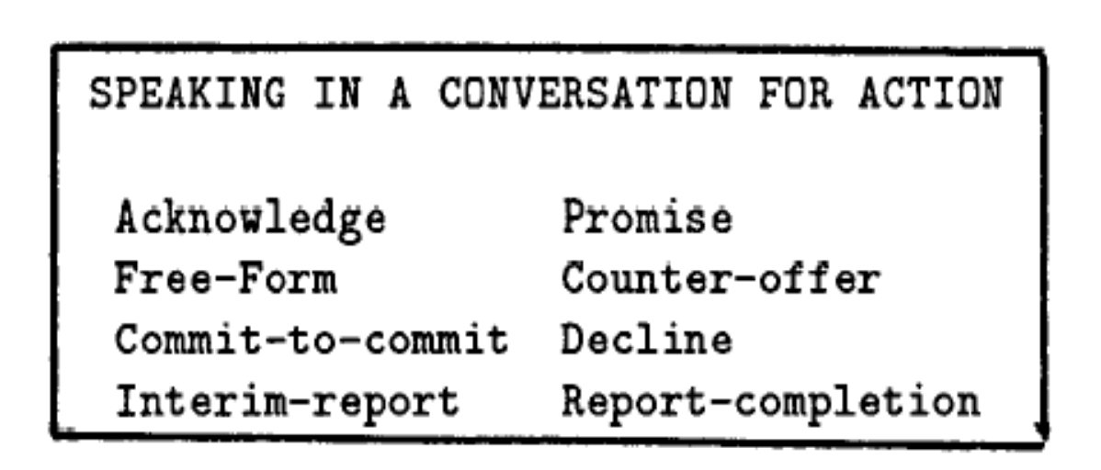
The Coordinator (email and other communication)
http://hci.stanford.edu/~winograd/papers/language-action.html

Slide 11
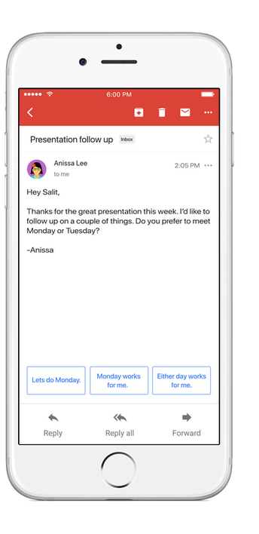
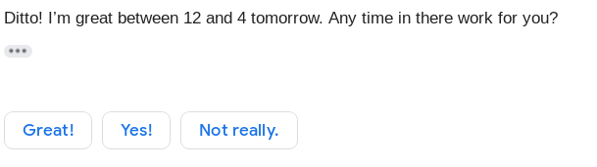

Slide 12
Lucy Suchman’s situated actions
The basic argument is that the categorical framework offered by speech act theory provides a particularly attractive foundation for designers interested in inscribing a formal structure of communications into their technology.
My "hostility," then, is not to "the disciplinary power of category" (p. 49) but rather, as I stated earlier, to the premise that some others are in a position to know better which categories are good for us as organization members than we do ourselves.
https://www.lri.fr/~mbl/ENS/CSCW/2012/papers/Suchman-JCSCW95.pdf

Slide 13
Thought Exercise:
Where do rules fit in?
What advantages and disadvantages does each approach have?
Do realistic applications need both? Or just one, based on the application?

Slide 14
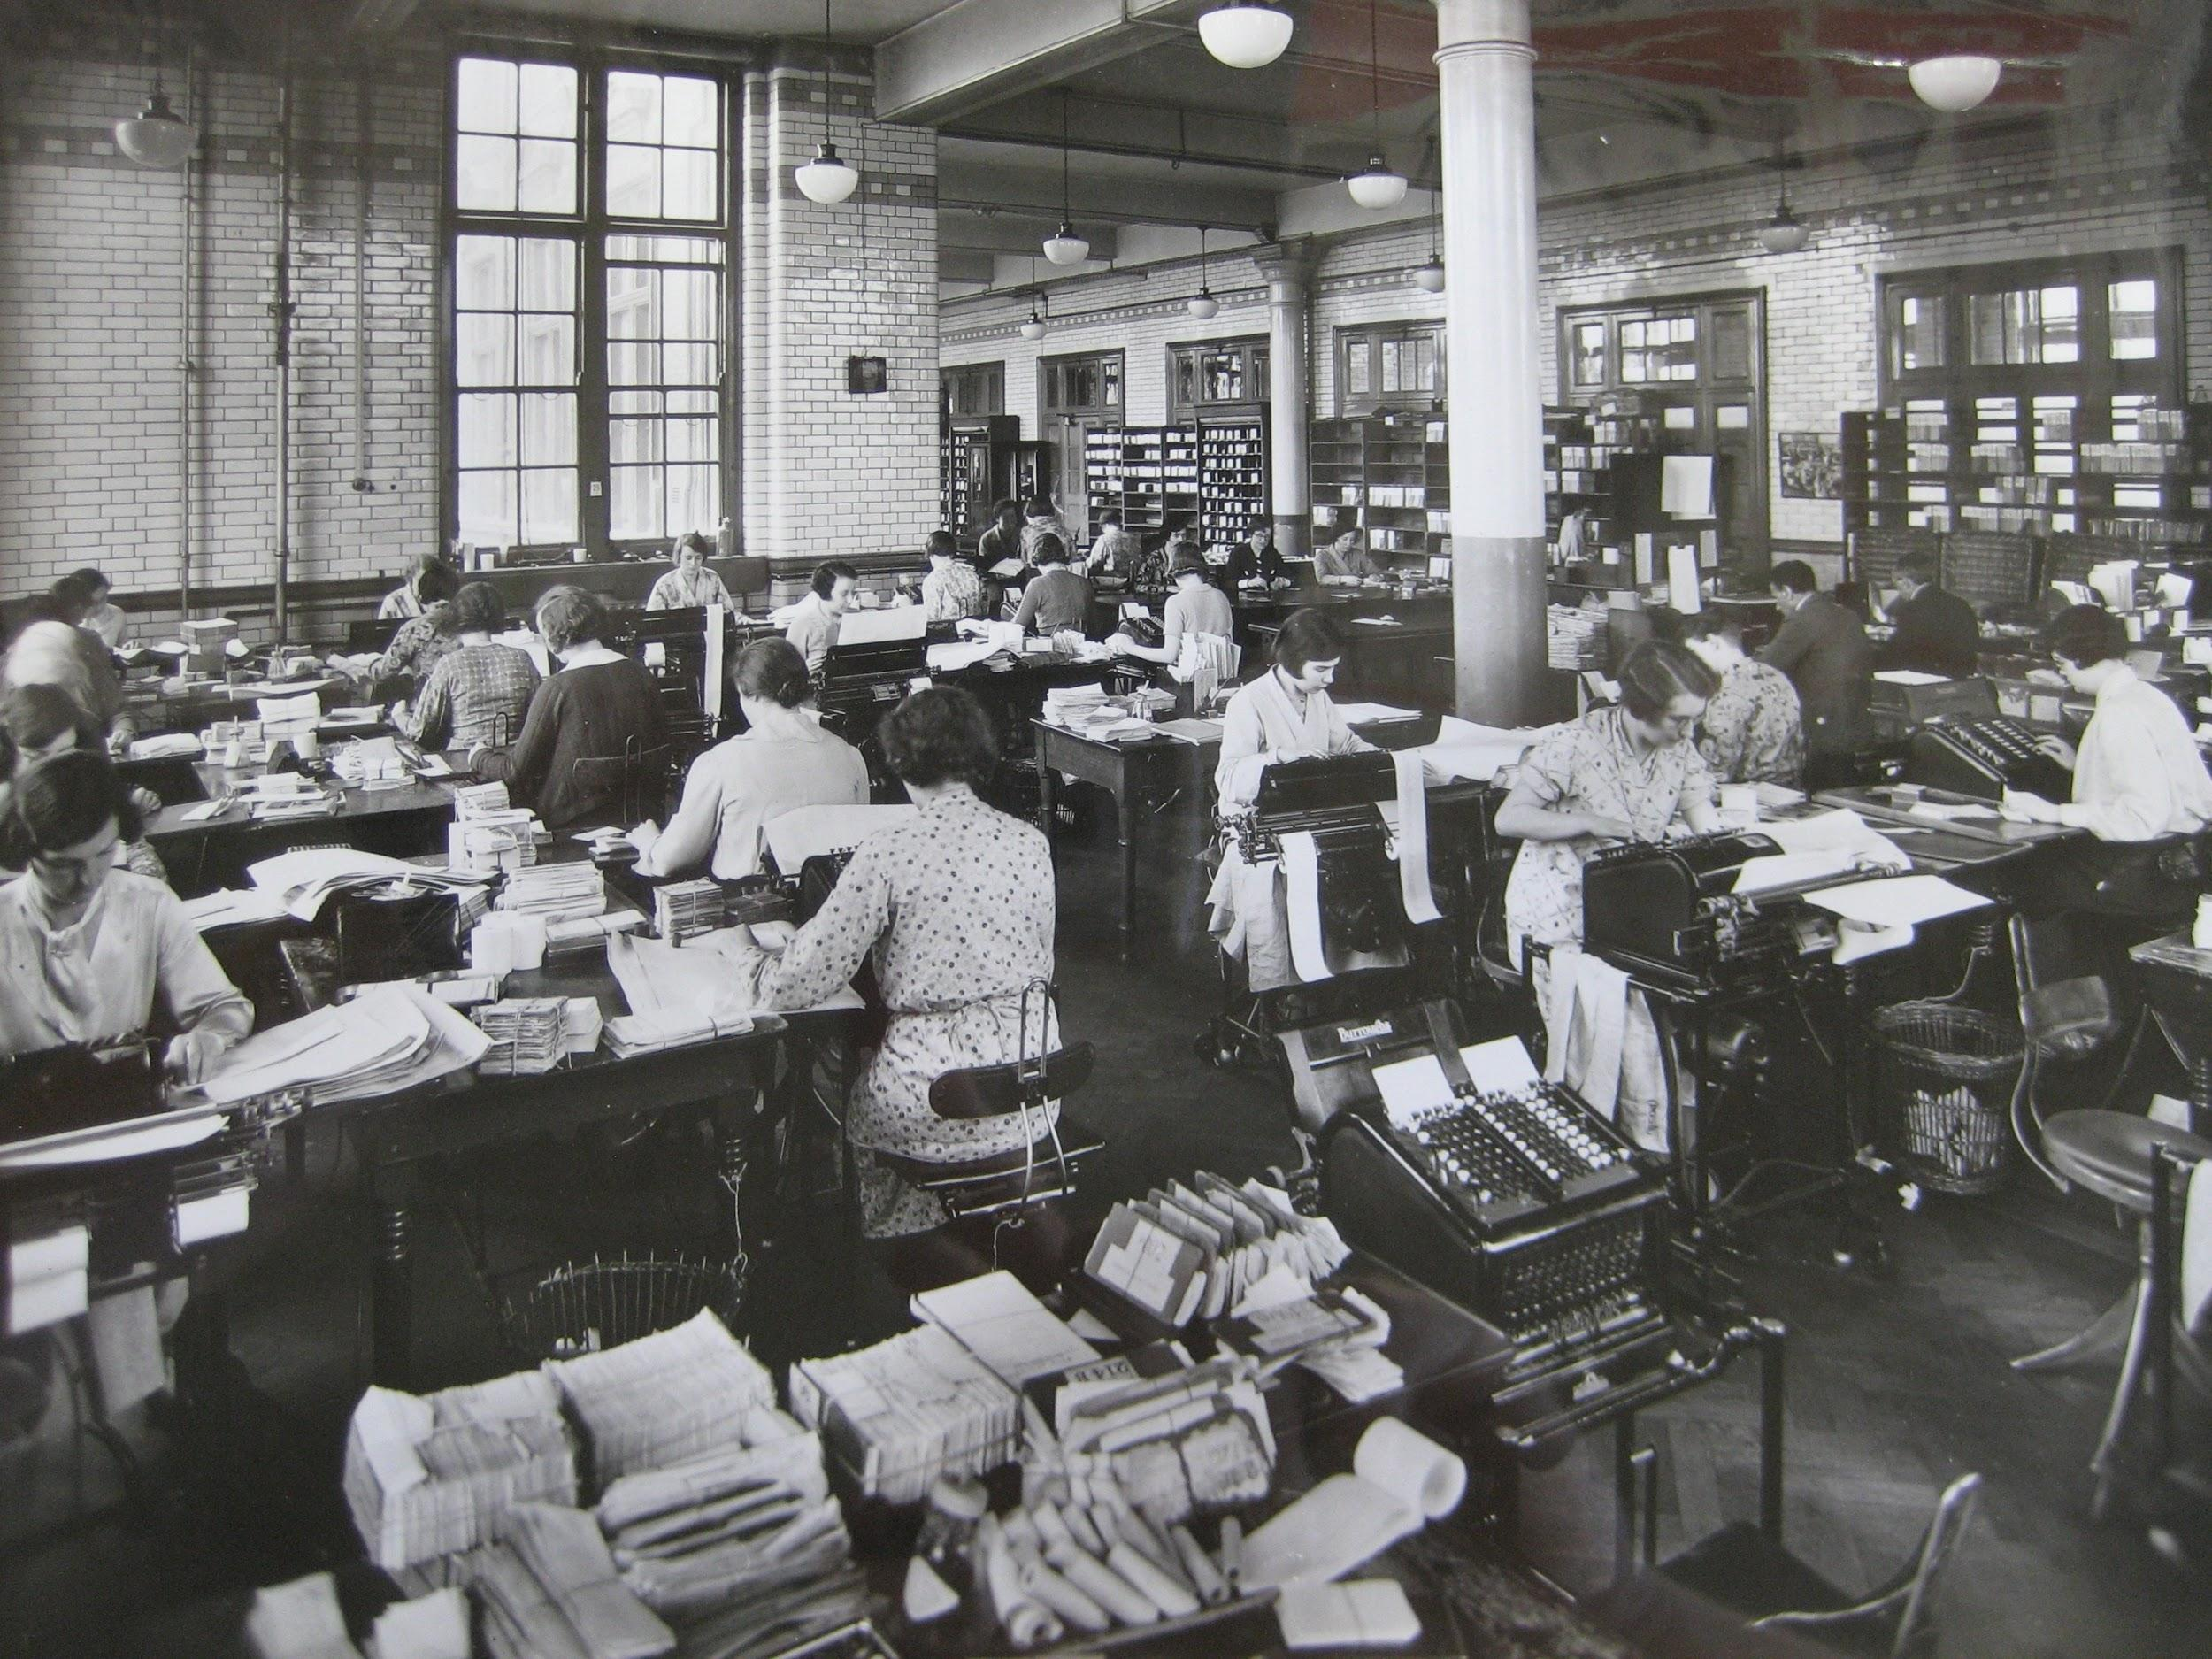
“Oh, and everyone had secretaries!”

Slide 15
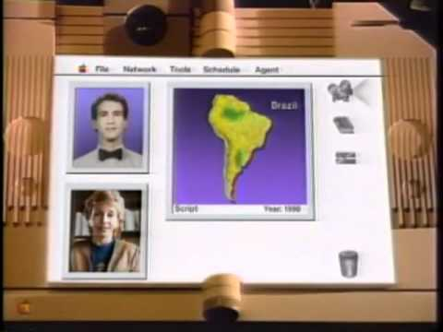
The Apple Knowledge Navigator (1987)

Slide 16
Are we there yet?
What parts of augmentation have we achieved?
What parts have we not?
Why not?

Slide 17
Where is there anyway?
Is intelligence augmentation a good strategy to build AI systems?
Where might it be problematic?

Slide 18
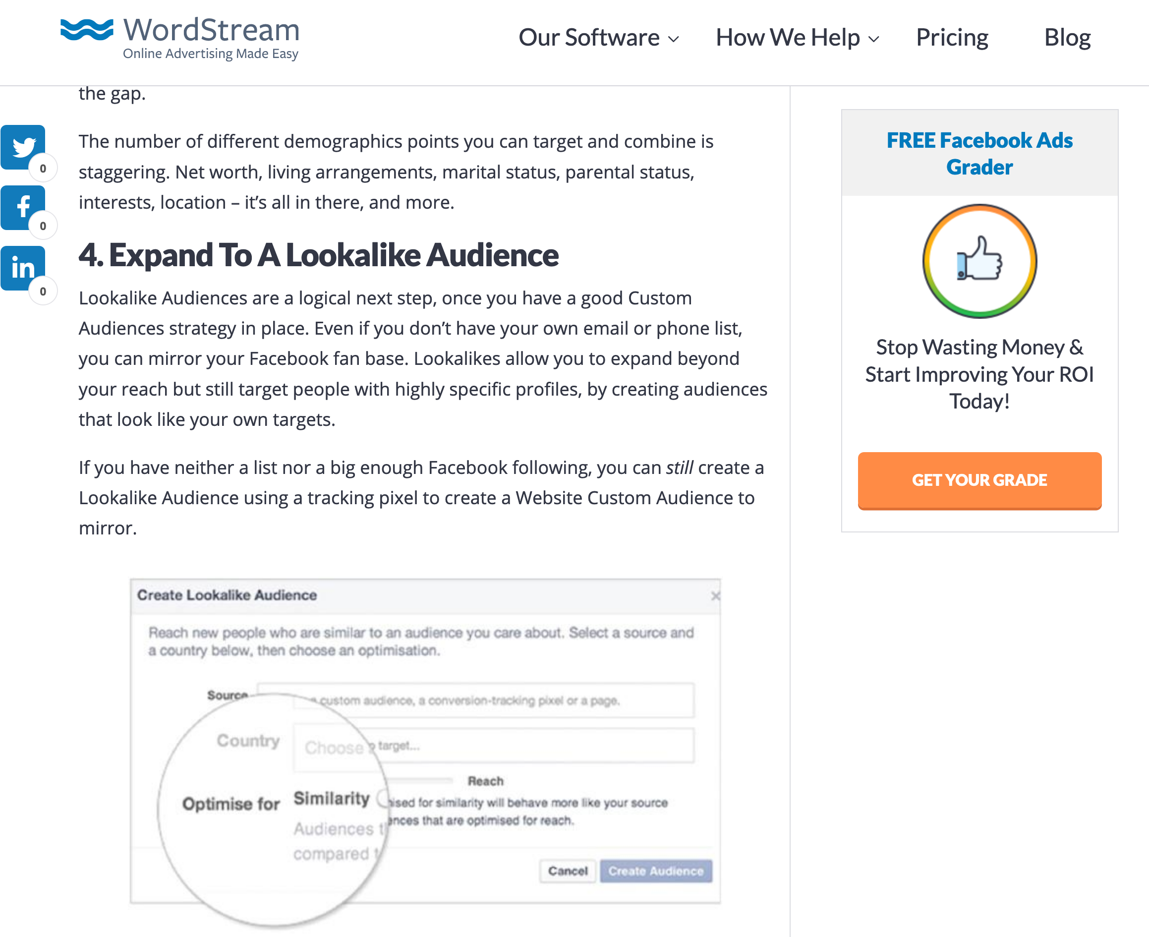
Targeted advertising
Is it intelligence augmentation?
For whom?

Slide 19

Intelligent/automatic
drinks maker
CocktailsMachine is a tailor-made solution for Bars, Casual Dining and Hotels
No need for dedicated staff and no training required, a simple and intuitive interface provide step by step instructions.
It takes an average of 5 seconds to pour a consistent and perfectly dosed Cocktail. From www.cocktailsmachine.com

